Slide 1
A World Of Possibilities

Slide 2
In 1967, The FAWCO leadership understood that FAWCO clubs were serious about promoting education and expanding charitable work throughout the world…

Slide 3
…and established The FAWCO Foundation

Slide 4
To implement FAWCO’s philanthropic concerns and interests in the global community
By aiding charitable and educational programs
And supporting the rights of women and children throughout the world

Slide 5
Over the last 47 years, The FAWCO Foundation has worked diligently to fulfill its purpose

Slide 6
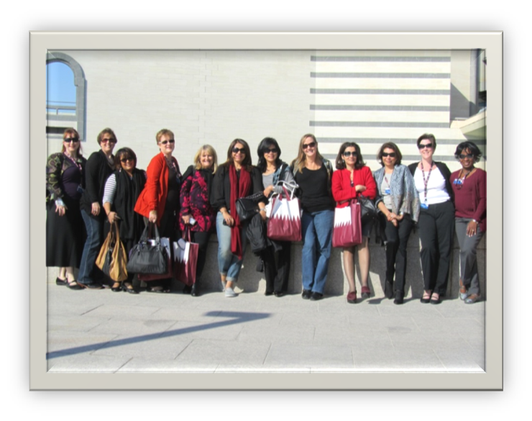
FAUSA, FAWCO clubs and their members are
truly AMAZING
Region 9 Meeting - Doha

Slide 7
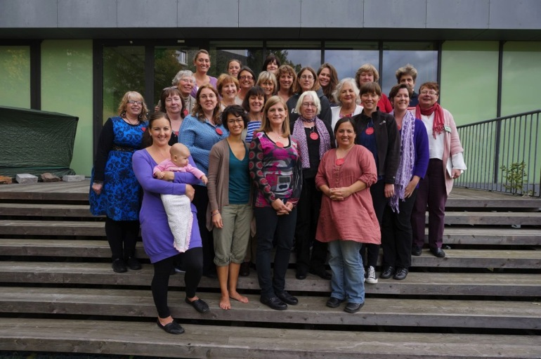
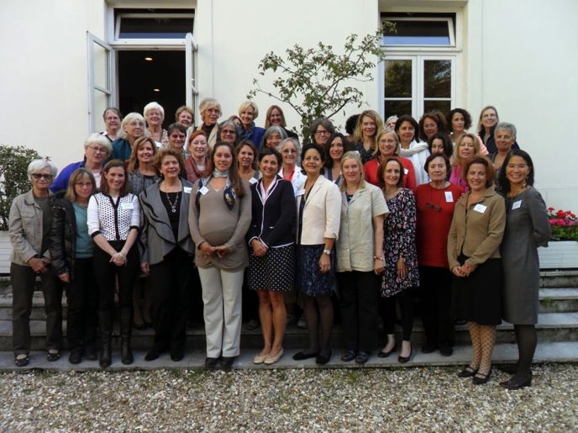
They give their time,
Region 2 Meeting - Gothenburg
Region 3 Meeting - Paris

Slide 8
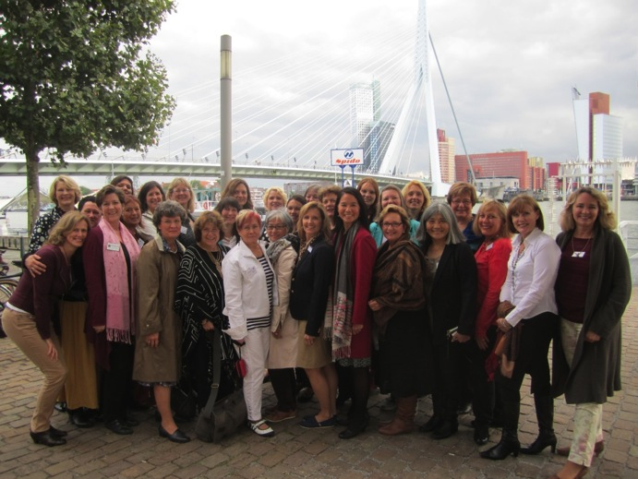
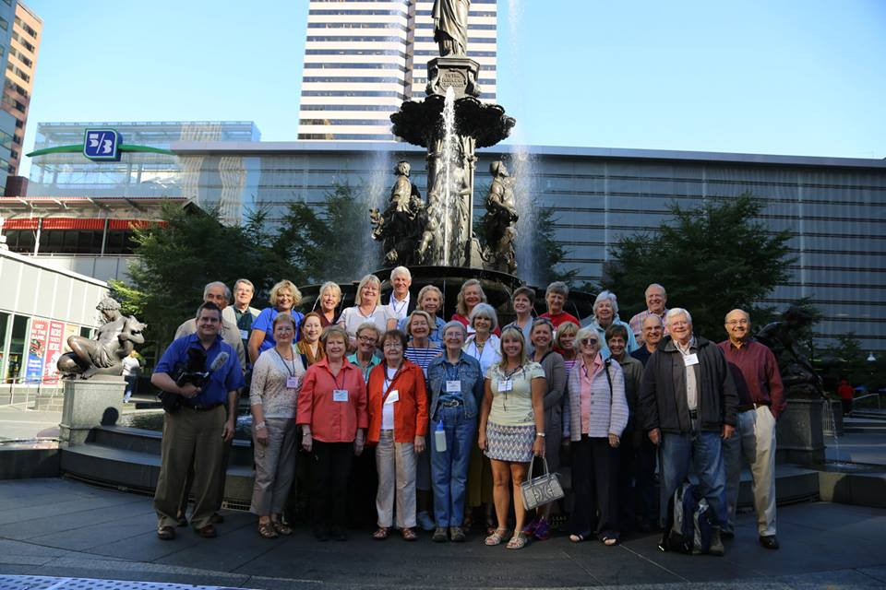
their energy,
Region 4 Meeting –
Rotterdam
FAUSA Getaway - Cincinnati

Slide 9
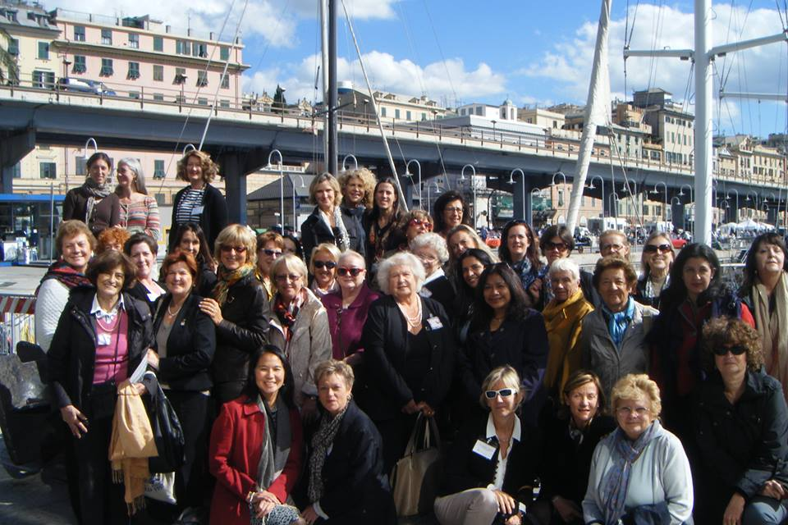
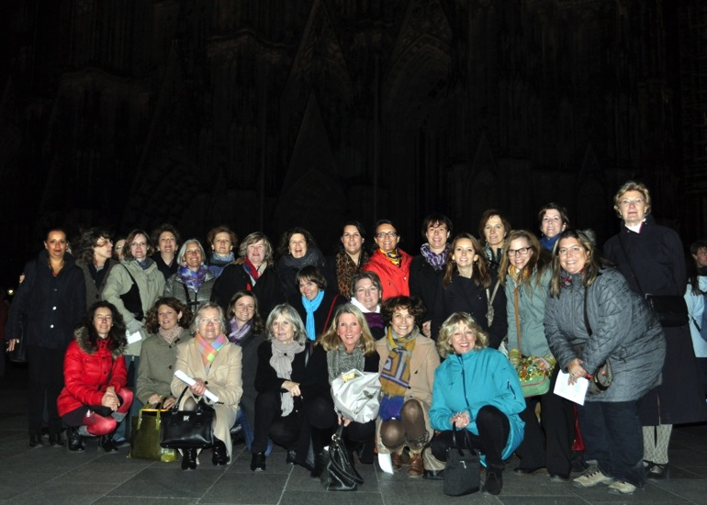
and their talents
Region 8 Meeting –
Genoa
Region 5 Meeting - Cologne

Slide 10
To quench the thirst for knowledge of those who have been deprived of it
To protect the environment and encourage ecological sustainability

Slide 11
To lift the burden from those who are too weak or too sick to do it themselves
To break down the barriers of oppressive practices
And to end suffering the best that we can

Slide 12
There is no shortage of suffering

Slide 13
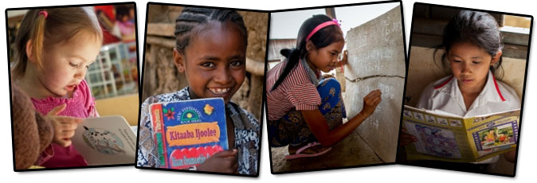
Women account for two thirds of the world’s 774 million adult illiterates.
Photos: savethechildren.org
72 million children -
54 % of them girls – are out of school.
The World’s Women 2010, UN Department Of Economic And Social Affairs

Slide 14
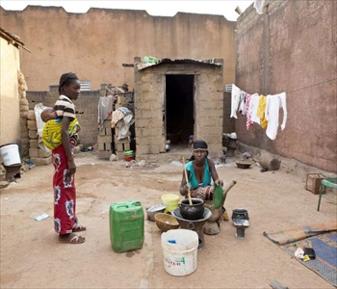
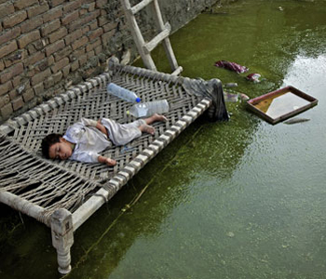
As much as 24% of global disease is caused by environmental exposures that can be averted.
Photos: unmultimedia.org
More than 33% of disease in children under the age of 5 is caused by environmental exposures. World Health Organization

Slide 15
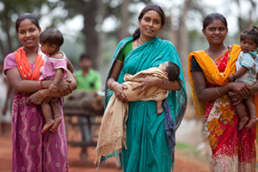
Every minute, at least one woman dies from complications related to pregnancy or childbirth – 287 000 women a year.
Image: Link Newspaper
In addition, for every woman who dies in childbirth, around 20 more suffer injury,
infection or disease – approximately 10 million
women each year. World Health Organization

Slide 16
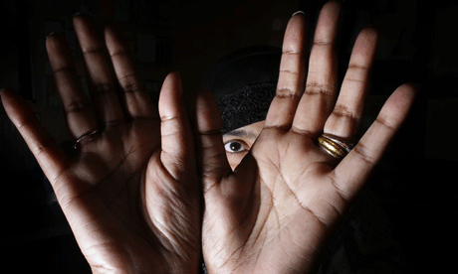
Globally, 35% of women have experienced either physical and/or sexual intimate partner violence or non-partner sexual violence. The majority is intimate partner violence. World Health Organization
Photos: Christopher Thomand, sheknows.com, wording.org

Slide 17
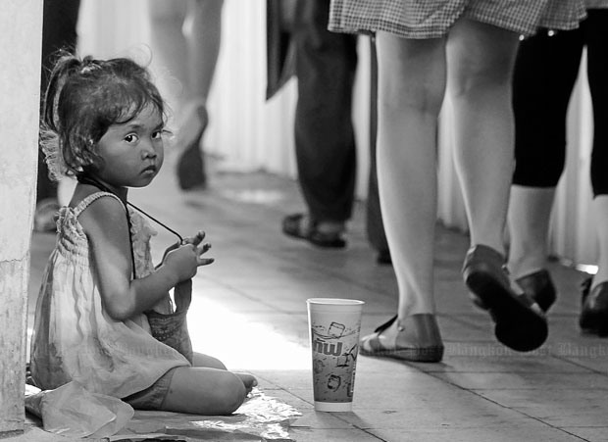
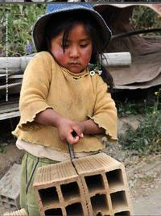
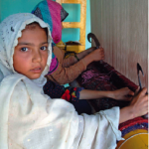
Globally, approximately 20.9 million people are victims of forced labor.
75% of trafficking victims are female, 58% of those are trafficked into the commercial sex industry. UNODC 2012 Global Report on Trafficking in Persons
Photos: worldnewstoday.com, notforsalecampaign.org, Apichit Jinakul burmanationalnews.org, counterchildtrafficking.org

Slide 18
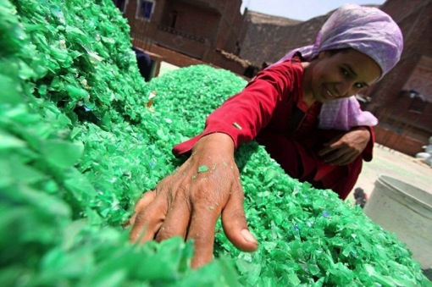
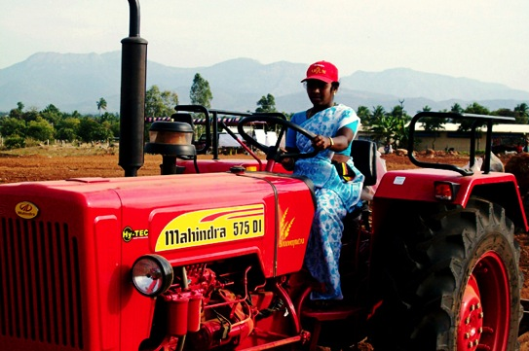
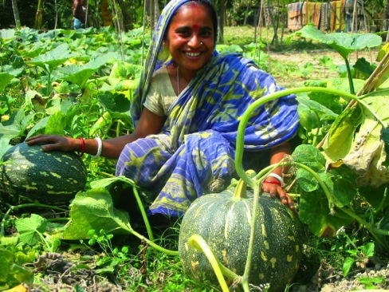
If women in rural areas had the same access to land, technology, financial services, education and markets as men, the number of hungry people could be reduced by 100-150 million. Food And Agriculture Organization of The United Nations
Photo: world.edu
Photo: rise.mahindra.com
Photo: usaid.gov

Slide 19
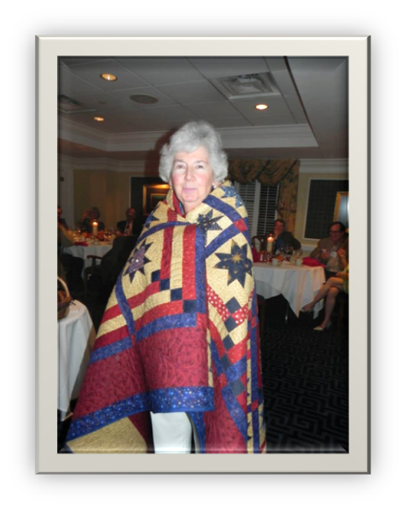
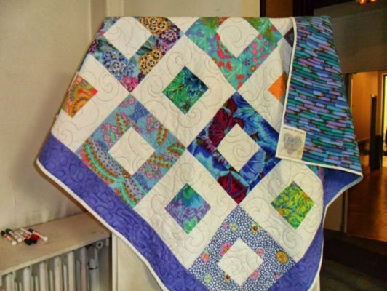
Around the World, FAUSA and FAWCO Members Make a Difference
Region 3 - Quilt Raffle for
Target Project
FAUSA Raffle Quilt
2014 FAWCO
Friendship Quilt

Slide 20
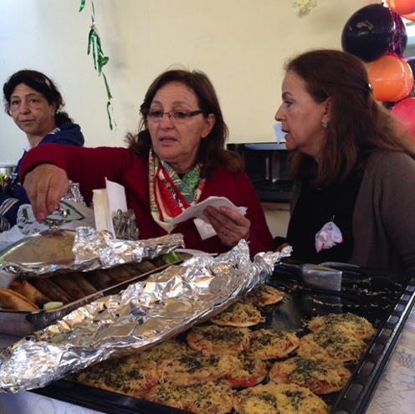
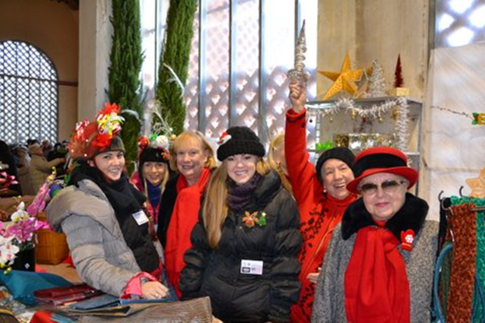
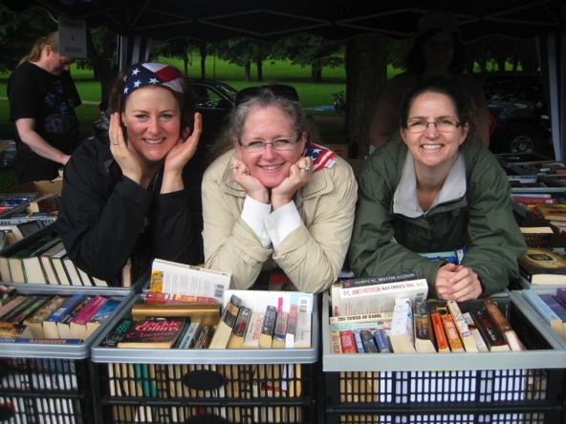
Selling and Shopping for Charity
AIWC Casablanca
Christmas Fair
AILO Florence Christmas Bazaar
AWC Oslo Book Sale

Slide 21
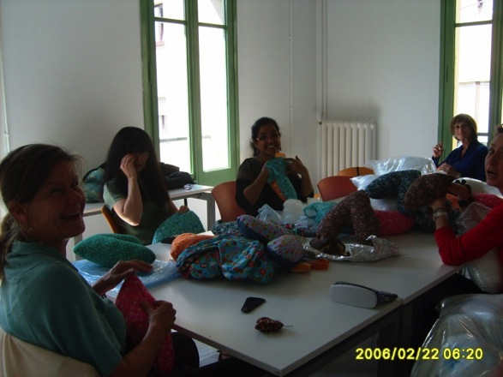
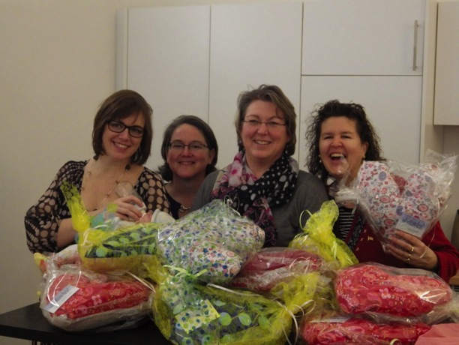
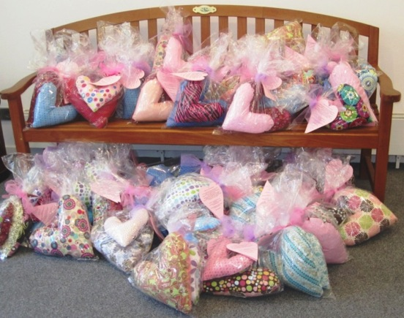
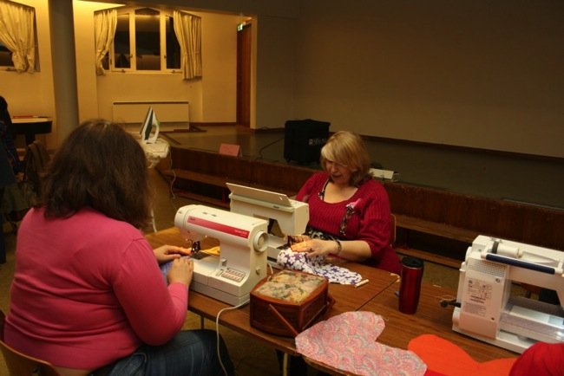
Heart Pillows
Barcelona Women’s Network
AWC Hamburg
ANCOR & AWC The Hague
AWC Oslo

Slide 22
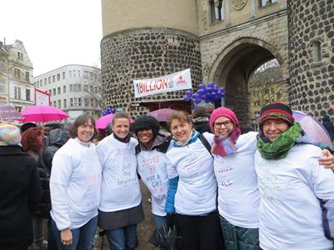
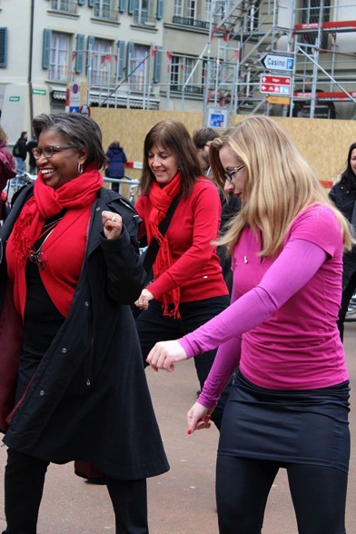
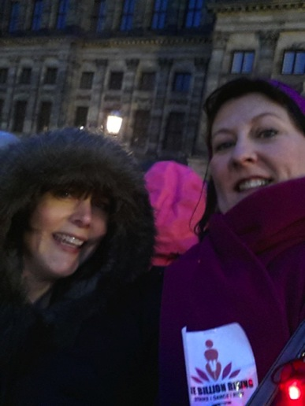
One Billion Rising
AIWC Cologne
AWC Amsterdam
AWC Bern
Barcelona Women’s Network

Slide 23
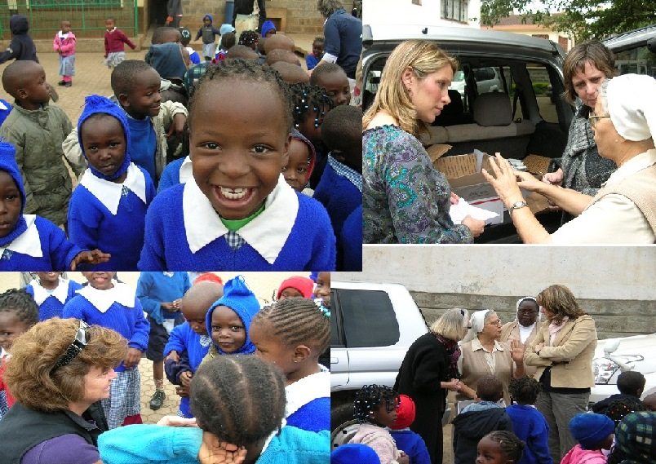
Local Charities
and Community Work
AWA Kenya – Feeding Program – Nairobi

Slide 24
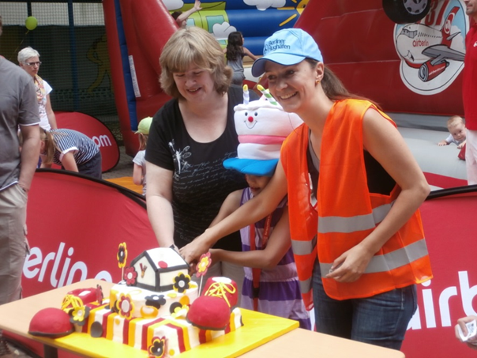
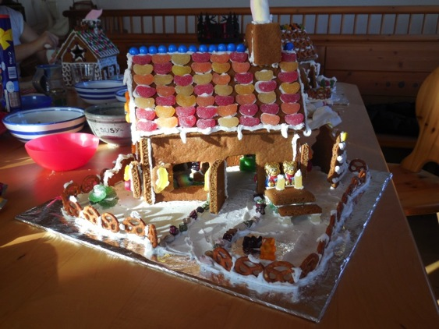
AWC Berlin –
Ronald McDonald House
Munich IWC – Gingerbread Houses for Frauenhaus
AIWC Genoa – Gardening in Staglieno Cemetery

Slide 25
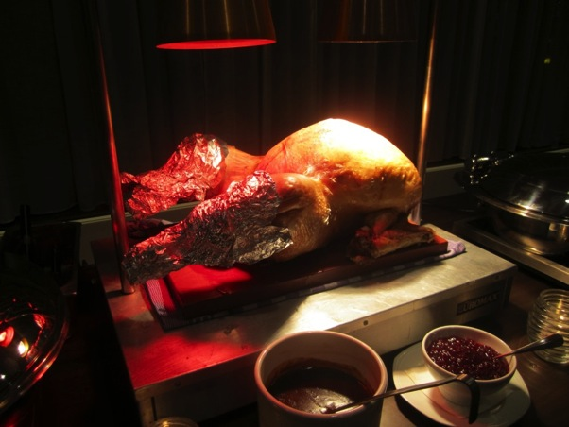
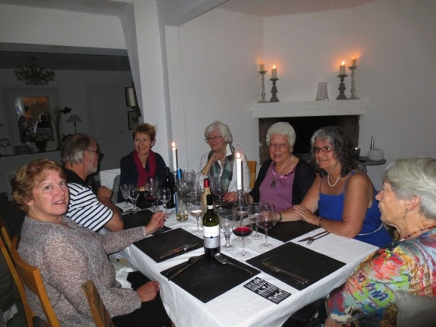
Food and Fun for Charity
ANCOR Thanksgiving Dinner
AIWC Genoa – St. Patrick’s Party
AWG –LR Fundraising Dinner

Slide 26
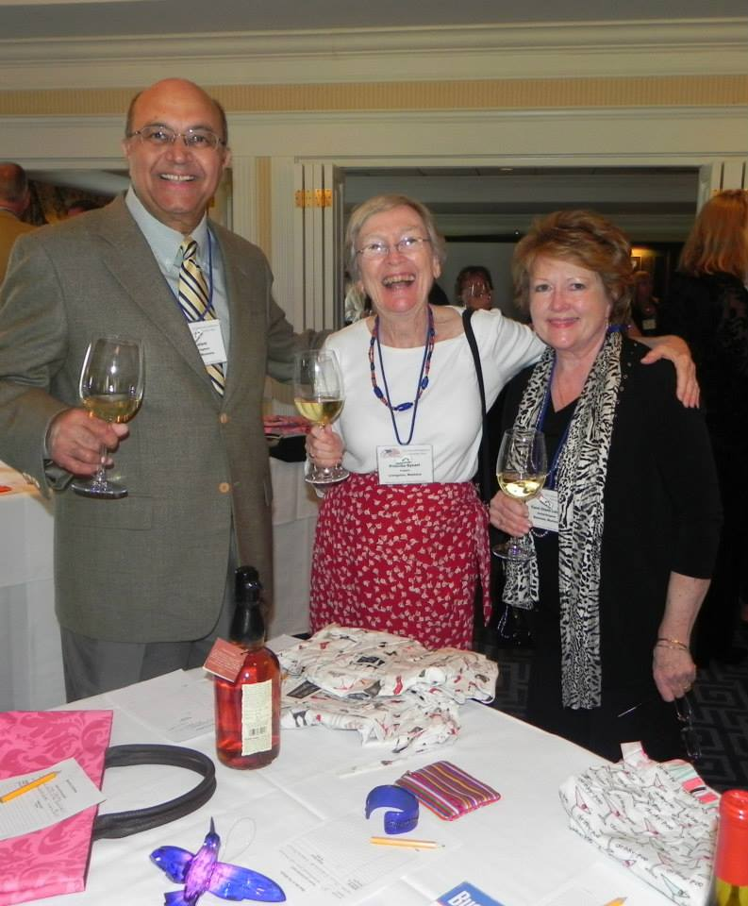
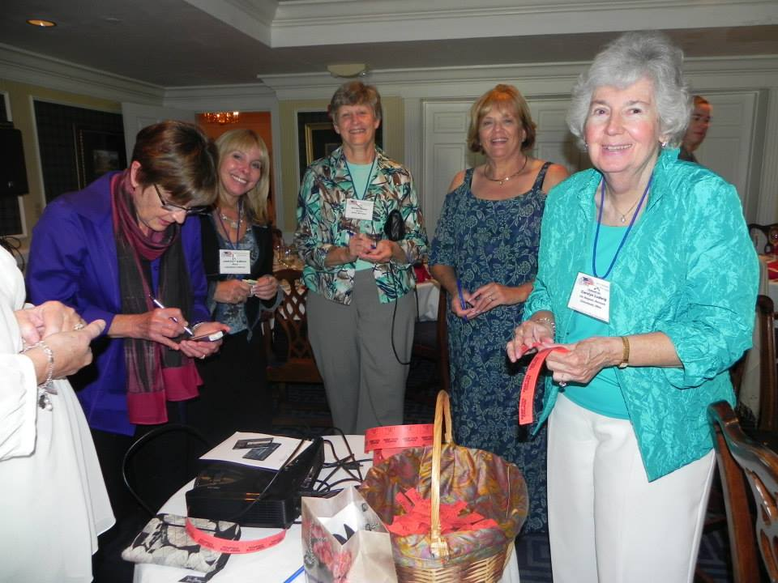
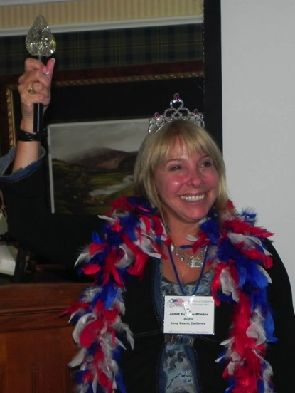
FAUSA
Charity
Friends
FUN!

Slide 27
So continue to amaze us with your generosity and help us
Change lives,
Change minds,
Change the world,
There is a World of Possibilities

Slide 28
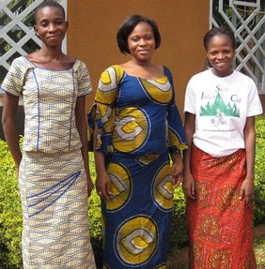
The FAWCO Foundation’s Core Programs
NEEED Scholarships

Slide 29
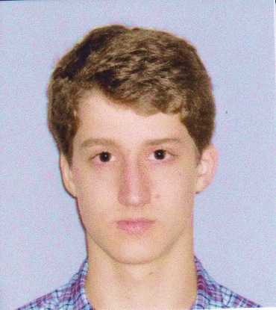
2013 Education Award Recipients
Sciences Award
Sponsored in part by AIWC Genoa,
in memory of Frieda Bacigalupo Natali
and AWC Zurich
Wilson Brace

Slide 30
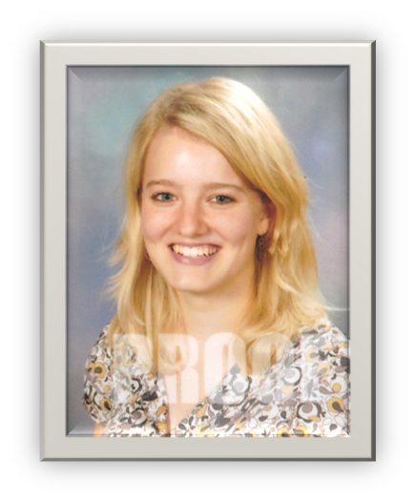
Humanities Award
Sponsored in part by AAWE,
in memory of Gertrude de Gallaix
Laura Brace

Slide 31
2nd Humanities Award
Sponsored in part by Donna Erismann and AWC Bern,
in memory of Suzanne Erismann
Thaddeus Jahn

Slide 32
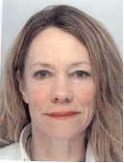
AWC Basel Award
for University Degree Study Programs
Sponsored by Shirley Kearney
Tamara Chant
AWG Paris

Slide 33
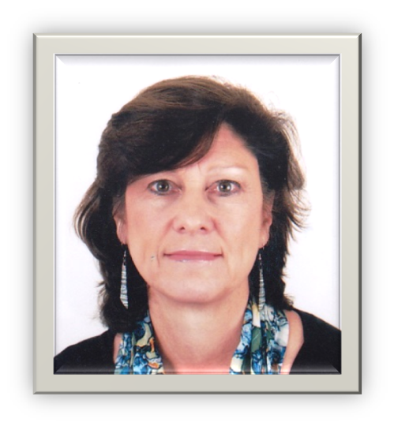
FAUSA Skills Enhancement Award
Therese Hartwell
AW of the Eastern Province

Slide 34
2013 Development Grant Recipients

Slide 35
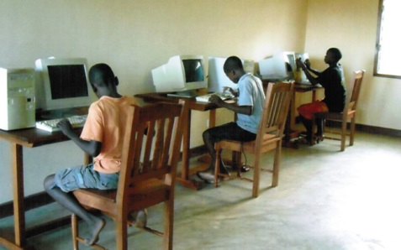
Pam Dahlgren Educating Africa's Children
Mama Anakuja, Malinda, Kenya

Slide 36
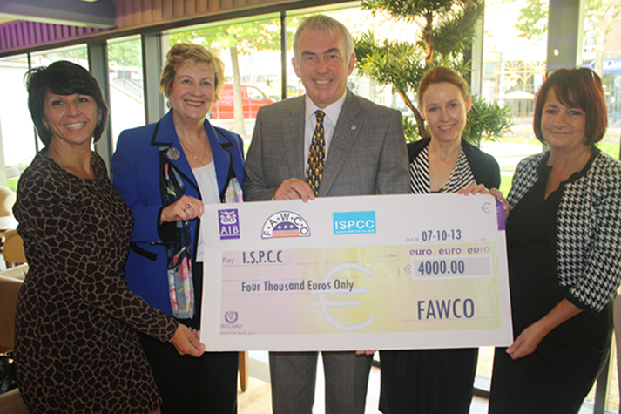
Around the Corner, A World Away
Sponsored in part by AIWC Genoa
in memory of Carol Bordoni
Irish Society for the Prevention of Cruelty to Children, Dublin, Ireland

Slide 37
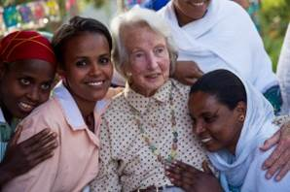
Critical Health Concerns
Sponsored in part by AWC Zurich
The Fistula Foundation, Ethiopia

Slide 38
The Right to Food and Water Sponsored in part by FAUSA and the Copley Family
Amis de Ecoles, Tata, Morocco

Slide 39
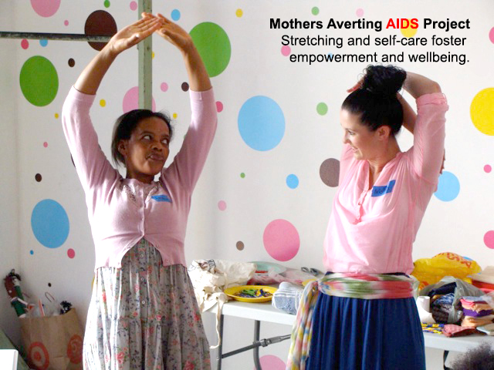
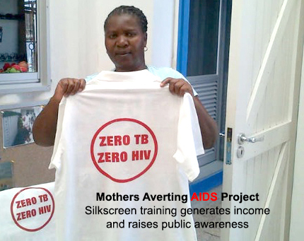
The Coughlan Foundation, Prevention and Treatment of HIV/AIDS, Malaria and Tuberculosis
Mothers Adverting AIDS - South Africa

Slide 40
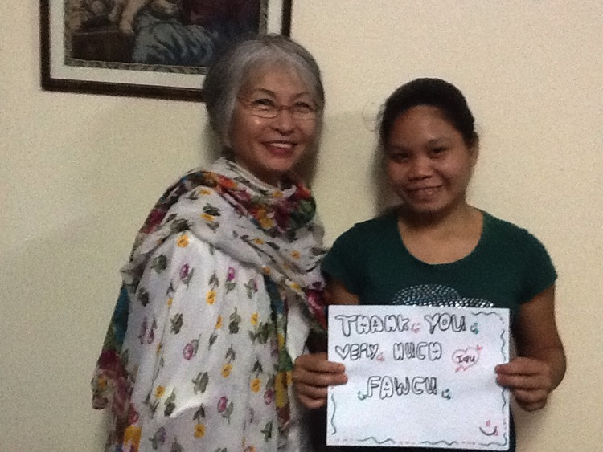
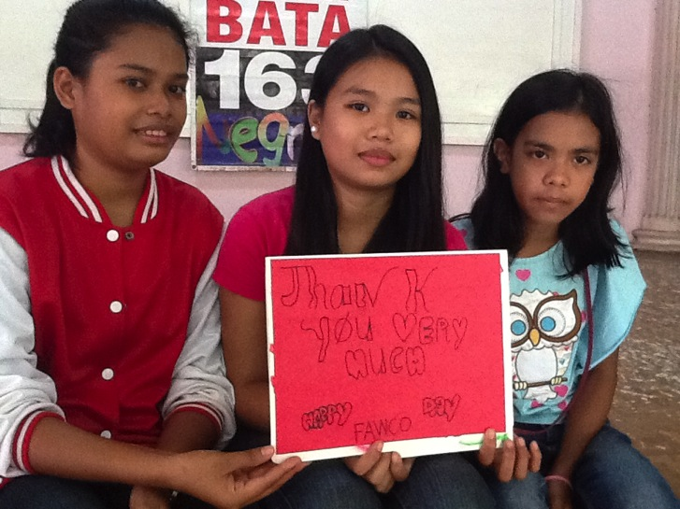
AW of Surrey Hope Through Education
SPOSA Child, Negros, Philippines

Slide 41
A few of the 2013 NEEED Scholarship Recipients

Slide 43
Human Rights For Women

Slide 44
Over the last 47 years, The FAWCO Foundation has worked diligently…
To fulfill its purpose

Slide 45
To this day,
we continue to support
Your projects
Your passions
Because we are
Your Foundation

Slide 46
We look forward to seeing you
Friday at Foundation Night!

